Slide 1
A R ENGINEERING COLLEGE VILLUPURAM-605601
PROJECT MEMBERS UNDER THE GUIDANCE OF
S.SURYA (420322213016) Ms.DEEPALAKSHMI
R.SURESH(420322213015)
J.YOGESHWARAN (420322213019)

Slide 2
Hospital Performance and Patient Analytics

Slide 3
ABSTRACT:
1.Problem Statement: Hospitals struggle with long waiting times, high costs, frequent readmissions, poor reporting, and lack of doctor performance evaluation.
Project Goal: Transform raw hospital data into actionable insights to improve efficiency, patient care, and financial outcomes.
3.Data Sources: Patient records, appointments, treatments, billing, and doctor performance metrics are analyzed.
4.KPIs Measured: Average waiting time, readmission rate, bed occupancy, revenue per department, and doctor utilization rate.
5.Tools & Outcomes: Python, SQL, and Power BI are used to build dashboards that help administrators optimize resources, reduce waiting times, and improve hospital performance, with potential for predictive modeling in the future.
Improvements:
• Operational efficiency
• Patient care
• Revenue tracking
• Doctor performance

Slide 4
Introduction:
The Hospital Performance & Patient Analytics System is a data analytics platform designed to analyze hospital operations and patient-related data to improve healthcare management. Hospitals generate a large amount of data such as patient records, doctor performance, treatment details, and hospital resource usage. Analyzing this data manually is difficult and time-consuming.
This system uses Python-based data analytics techniques to process hospital data and generate meaningful insights. The system allows administrators to monitor hospital performance through visual dashboards and reports. It helps identify trends such as patient admission rates, doctor performance, treatment outcomes, and department efficiency.
The frontend interface provides a user-friendly dashboard where hospital administrators can view charts, graphs, and reports generated from the analyzed data. This helps hospital management make better decisions to improve patient care and operational efficiency.

Slide 5
Objective:
To analyze hospital and patient data using Python data analytics tools.
To create visual dashboards for monitoring hospital performance.
To track patient admission trends and treatment statistics.
To evaluate doctor and department performance.
To help hospital administrators make data-driven decisions.
To present complex healthcare data in an easy-to-understand visual format.

Slide 6
Dataset overview :
• Raw dataset: Hospitaldata.csv
• Cleaned dataset: Final_Cleaned_Hospital_Data.csv
• Data cleaning done using Pandas

Slide 7
DATA CLEANING
Before analysis, data was cleaned using Python(Pandas library) to ensure accuracy, consistency, and usability.

Slide 8
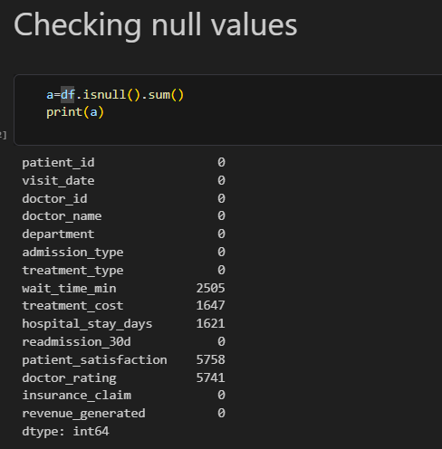
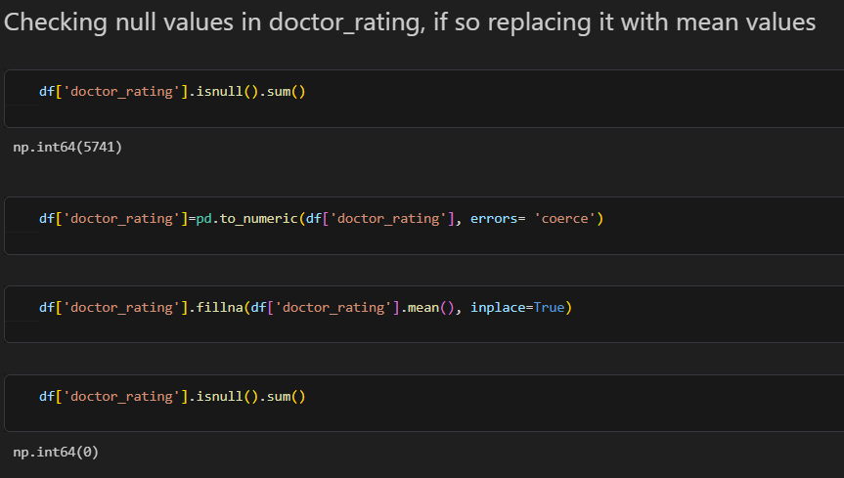
DATA CLEANING : Missing Values
• Identified missing values (NULL, NA, blanks) • Handled them using appropriate techniques

Slide 9
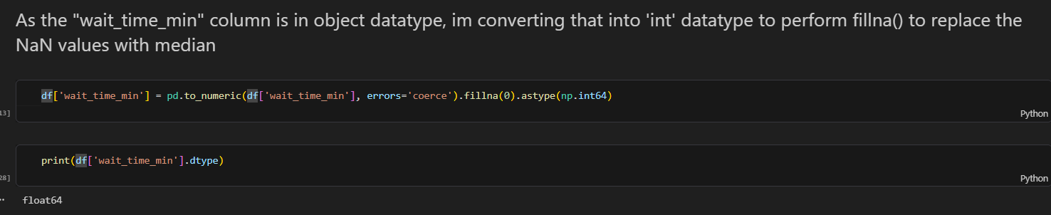
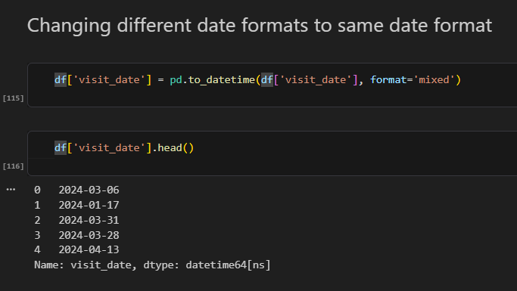
DATA CLEANING : Data Types
• Converted columns into correct data types • Ensured numerical and date fields were usable

Slide 10
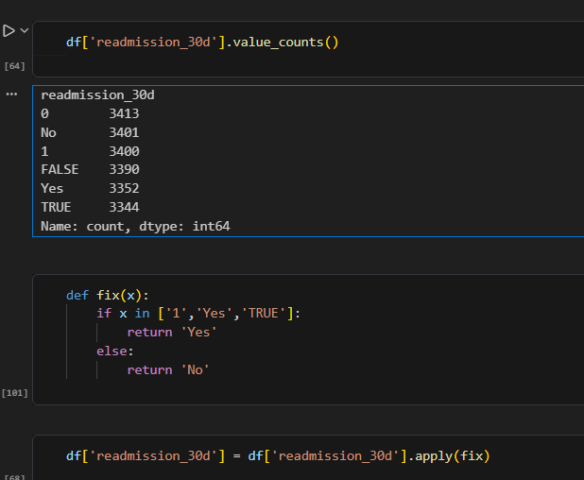


DATA CLEANING : Standardization
Before cleaning:
After cleaning:
• Standardized categorical values (Yes/No, text formats) • Fixed inconsistent departments

Slide 11
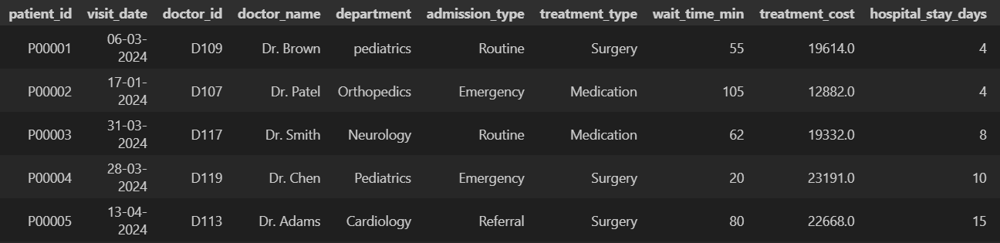
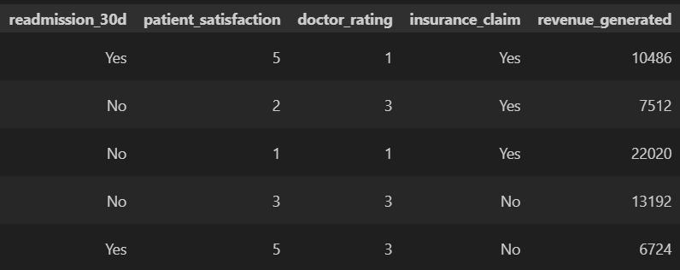
DATA CLEANING : Final Output
• Generated a clean and structured dataset • Ready for SQL and Power BI

Slide 12
SQL Processing
• Imported cleaned data into SQL • Modified incorrect data types • Performed validation and analysis

Slide 13
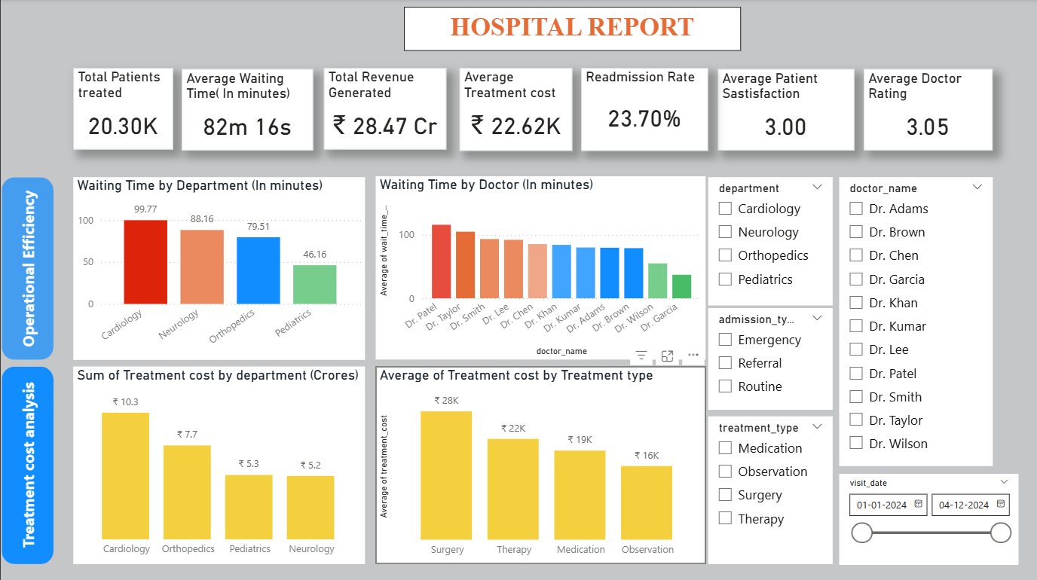
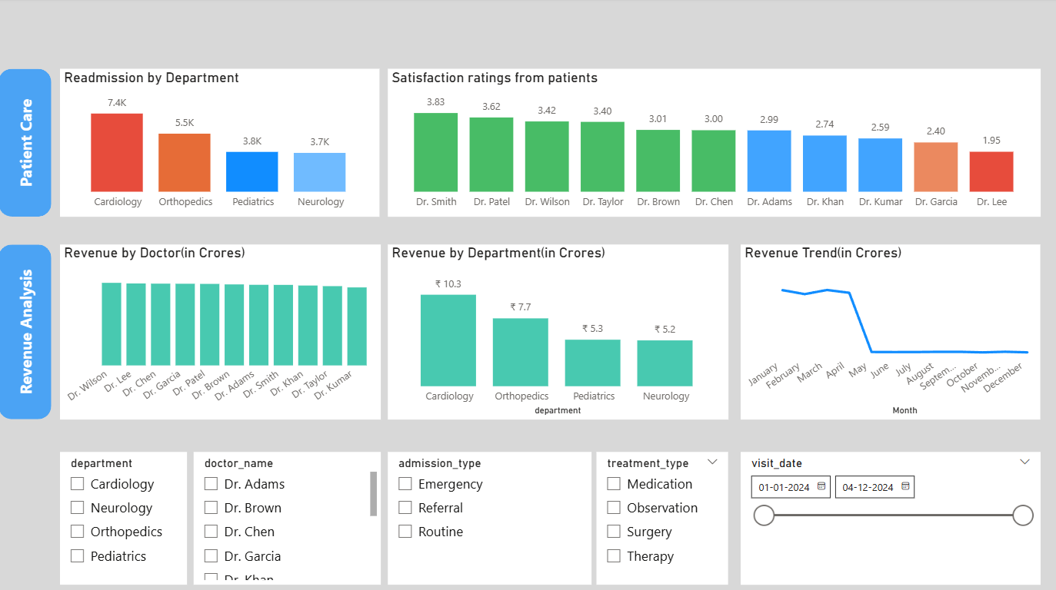
Dashboard Overview
Built an interactive Power BI dashboard to analyze:
Waiting time
Treatment cost
Readmission rate
Doctor performance
Revenue trends

Slide 14
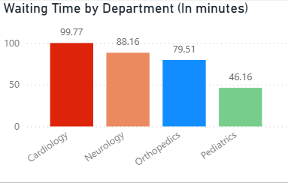
Waiting Time Analysis
• Cardiology has highest waiting time • Pediatrics has lowest • Indicates resource imbalance

Slide 15
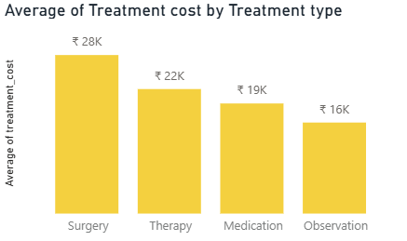
Cost Analysis
• Surgical treatments consistently show the highest average cost, indicating resource-intensive procedures • Observation-based treatments have significantly lower costs, making them the most economical option • This suggests that cost optimization efforts should focus on high-frequency surgical procedures

Slide 16
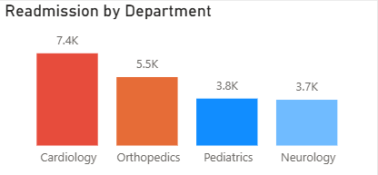
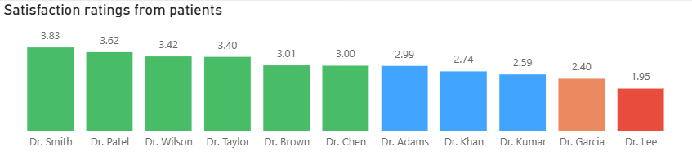
Patient Care Analysis
• Cardiology and Orthopedics shows the highest readmission rate, indicating possible challenges in handling complex cases • Other departments show relatively lower readmission rates, suggesting better recovery outcomes
Patient satisfaction differs across doctors

Slide 17
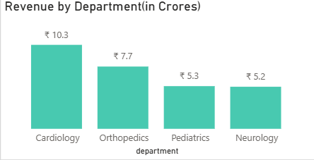
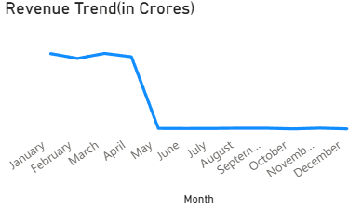
Revenue Analysis
• Cardiology contributes the highest share of hospital revenue, driven by high-cost treatments and patient volume • Revenue is concentrated among a few departments, indicating dependency on specific specialties • Revenue trends over time show stable growth, helping in financial planning and resource allocation

Slide 18
Key Insights
• Cardiology experiences the longest waiting times, indicating potential resource constraints • Surgical treatments are the primary cost drivers in the hospital • Cardiology has higher readmission rates, suggesting areas for improvement in patient care • Doctors such as Dr. Smith and Dr. Patel perform better in terms of patient satisfaction, while others may require improvement

Slide 19
Conclusion
• Identified operational inefficiencies • Improved data visibility • Enabled data-driven decisions • Provided actionable insights

Slide 20
Future Scope
• Predict readmission using ML • Automate reporting system • Real-time dashboard integration

Slide 21
THANK YOU

